Slide 1
Micro Credit /Microloan
Microcredit is the extension of very small loans, to impoverished borrowers who typically lack collateral, steady employment, or a verifiable credit history. It is designed to support entrepreneurship and alleviate poverty.

Slide 2
Microcredit Defaulter
MFI is provide two type of micro-credits on mobile balances to be paid back in 5 days.
The loan amount of 5 in Indonesian Rupiah, payback amount should be 6 (in Indonesian Rupiah).
The loan amount of 10 (in Indonesian Rupiah), the payback amount should be 12 (in Indonesian Rupiah).
The Consumer is believed to be defaulter if he deviates from the path of paying back the loaned amount within the time duration of 5 days.

Slide 3
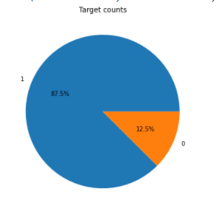
Microcredit Defaulter in Dataset
Around 12.5% are Defaulter in Datasets

Slide 4
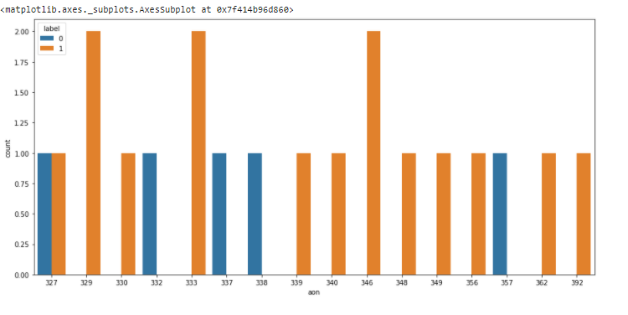
Top Cellular Age with respect to Defaulter and Non Defaulter.
Defaulter cellular age will come under 300 days.

Slide 5
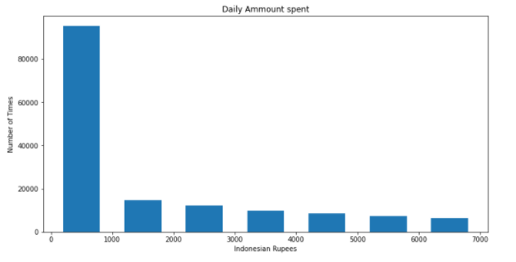
Average Amount uses in a month.
Less then 1000 Indonesian Rupees is used more then 8000 times.

Slide 6
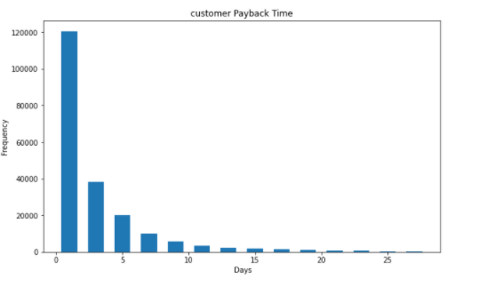
Average customer Payback Time
After Lone, payback time by customer is generally less then a week in 30 days.

Slide 7
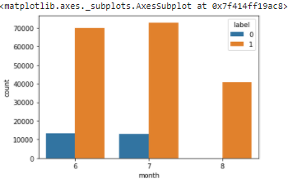
Numbers of Defaulter in Months
Numbers of Defaulter are in 6 & 7 Months-

Slide 8
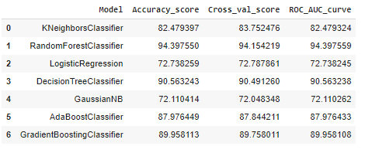
Modelling for predict results
There are 7 models is used for prediction of result .

Slide 9
Selection of Model
Among all only Random Forest classifier model are performing well in terms of accuracy and others.

Slide 10
Conclusion
The Defaulter doesn’t having old cellular connection because if we see the age of defaulter cellular , it always less than 300 days that mean most of people who having new connection is in defaulter list.
The other thing is Defaulter comes only in 6th and 7th months with maximum amount of loan is Rupees 6. Apart from that the tendency of main account is also very less as compare to Non defaulter.

